Slide 1
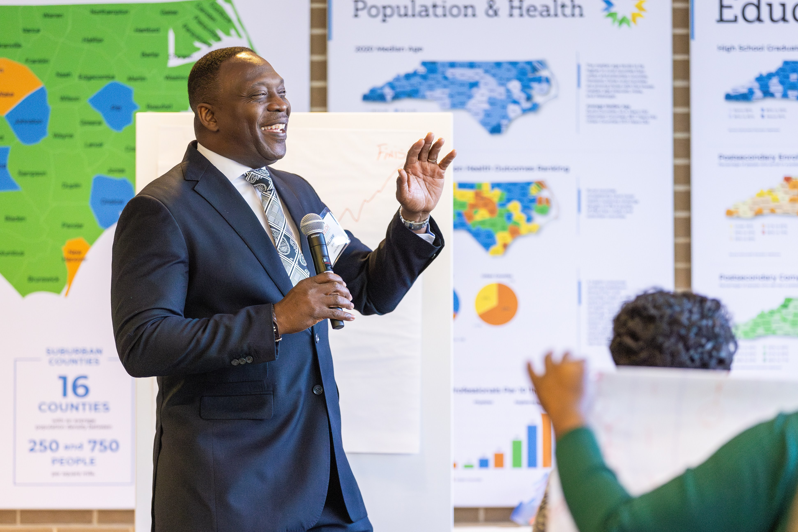
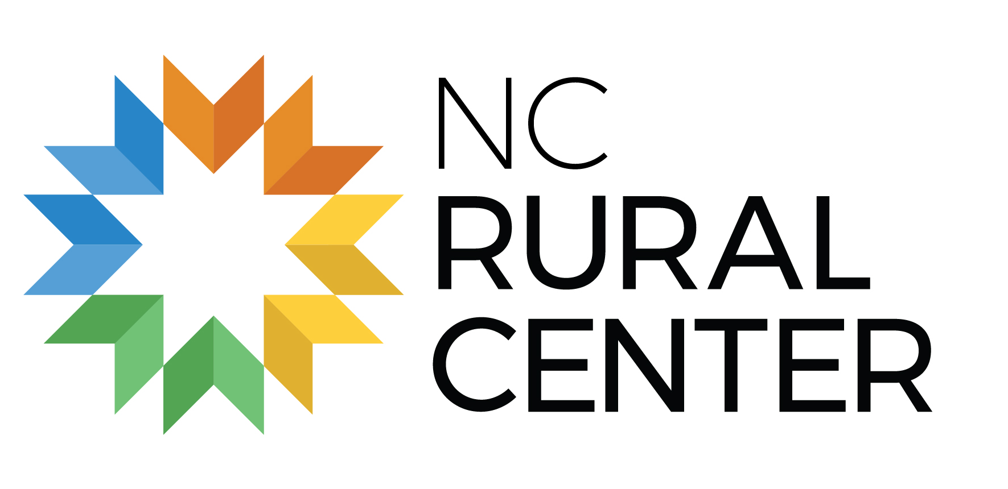
From Scarcity to Abundance: Building Vibrant Rural Communities with Asset-Based Development
Hamid Kamara
Faith in Rural Communities Program Manager

Slide 2
What is Asset-Based Community Development?
Notes:
Opening Line:
You may have heard of needs-based approaches to community work — where we focus on what's lacking, broken, or missing.
Asset-Based Community Development (ABCD) flips that model on its head.
Key Talking Points:
Definition of ABCD:
Asset-Based Community Development is a framework that starts with what’s strong—not what’s wrong.
Instead of beginning with deficits, we begin with the gifts, skills, resources, relationships, and stories that already exist within a community.
It’s about building from the inside out, rather than imposing solutions from the outside in.
Foundational Beliefs of ABCD:
Every person has something to contribute — skills, passions, lived experience.
Every neighborhood, even those labeled “under-resourced,” holds untapped potential.
Sustainable change comes with the community, not just for the community.
Why It Matters:
Asset-based approaches restore dignity.
They empower people to be co-creators of change, not just recipients of charity.
This model leads to more sustainable, rooted transformation because it strengthens local leadership and ownership.
Examples:
Instead of starting a food pantry, find out who in the community already cooks and host a community meal together.
Rather than bringing in outside experts to “fix” the neighborhood, identify and elevate resident leaders, faith leaders, artists, and youth with solutions already brewing.
Map out skills in your congregation or neighborhood: who knows carpentry, who loves organizing, who has cultural wisdom?
Engagement Questions:
Think about your own community — what are the hidden assets that often go unrecognized?
Where have we led with needs or deficits in the past? What would it look like to reframe that using an asset-based lens?
How might this shift in perspective change the way you engage, lead, or support your neighborhood?

Slide 3

COMMUNITY NEEDS:
Homelessness, Food Insecurity,
Transportation, Drug Addictions

Slide 4
Asset-Based Community Development is identifying and mobilizing the gifts and capacities of local people and the social, physical, and economic resources of a local place.

Slide 5
COMMUNITY ASSETS:
Relationships, Financial Support,
People, Facilities, Etc.
Notes:
Opening Line:
You may have heard of needs-based approaches to community work — where we focus on what's lacking, broken, or missing.
Asset-Based Community Development (ABCD) flips that model on its head.
Key Talking Points:
Definition of ABCD:
Asset-Based Community Development is a framework that starts with what’s strong—not what’s wrong.
Instead of beginning with deficits, we begin with the gifts, skills, resources, relationships, and stories that already exist within a community.
It’s about building from the inside out, rather than imposing solutions from the outside in.
Foundational Beliefs of ABCD:
Every person has something to contribute — skills, passions, lived experience.
Every neighborhood, even those labeled “under-resourced,” holds untapped potential.
Sustainable change comes with the community, not just for the community.
Why It Matters:
Asset-based approaches restore dignity.
They empower people to be co-creators of change, not just recipients of charity.
This model leads to more sustainable, rooted transformation because it strengthens local leadership and ownership.
Examples:
Instead of starting a food pantry, find out who in the community already cooks and host a community meal together.
Rather than bringing in outside experts to “fix” the neighborhood, identify and elevate resident leaders, faith leaders, artists, and youth with solutions already brewing.
Map out skills in your congregation or neighborhood: who knows carpentry, who loves organizing, who has cultural wisdom?
Engagement Questions:
Think about your own community — what are the hidden assets that often go unrecognized?
Where have we led with needs or deficits in the past? What would it look like to reframe that using an asset-based lens?
How might this shift in perspective change the way you engage, lead, or support your neighborhood?

Slide 6
Basic Components of ABCD
Asset Mapping
Relationship Building
Collaboration
Notes:
🔍 1. Asset Mapping
Talking Points:
Asset mapping is the process of identifying the gifts, talents, resources, institutions, and informal networks that already exist within a community.
We’re not just asking “What do you need?” but “What do you already have that can be built upon?”
These assets can be:
Individual (skills, passions, experiences)
Associational (clubs, faith communities, block groups)
Institutional (schools, nonprofits, small businesses)
Physical (parks, buildings, libraries)
Cultural (languages, traditions, rituals)
Example:
Instead of hiring someone to teach a youth program, what if you discovered a retired teacher already living in the neighborhood who’s passionate about mentoring?
Engagement Question:
When was the last time you asked someone in your community what they love doing—not just what they need?

Slide 7
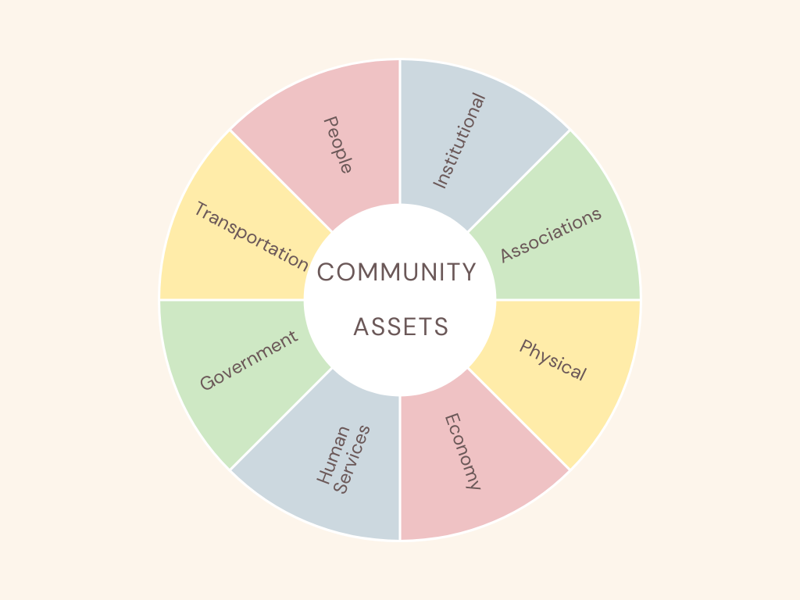
Small Group Asset Mapping
Notes:
Instructions
1. Break Into Small Groups (5 minutes)
Divide participants into groups of 3–6. Provide each group with:
A printed Community Asset Wheel
Sticky notes or markers
A blank sheet of paper for additional notes
Explain the five asset categories:
People (skills, gifts, leaders, volunteers)
Places (physical spaces, land, parks, buildings)
Institutions (schools, churches, nonprofits, agencies)
Associations (clubs, circles, informal networks)
Economic Capacities (local businesses, entrepreneurs, funding opportunities, barter/trade networks)
2. Group Asset Brainstorm (12–15 minutes)
Each group will work together to identify actual or hypothetical assets within their community context. Instruct them to:
Write one asset per sticky note.
Place each sticky note on the correct section of the asset wheel.
Encourage variety—small assets matter (e.g., “Miss Barbara who knows everyone on the street”).
Consider both existing resources and creative possibilities if they were imagining an ideal context.
Prompts you can give groups:
Who are the “quiet leaders” in your community?
What places do people naturally gather?
Which businesses or institutions support community life?
What informal groups exist—choirs, volunteer groups, youth teams?
What economic skills already exist among residents?
3. Prioritization Discussion (5 minutes)
Ask each group to look at their full wheel and discuss:
Which 2–3 assets feel most underutilized?
Which assets could be activated quickly for a community project?
Which assets surprised the group the most?
Groups record these insights on their blank sheet.
4. Group Share-Out (10–12 minutes)
Each group shares:
One asset from each category
One asset they believe is underutilized
One surprising asset or insight

Slide 8
Asset Types
Individuals
Associations
Institutions
Physical Space
Exchange/Economy
Culture/Stories/History

Slide 9
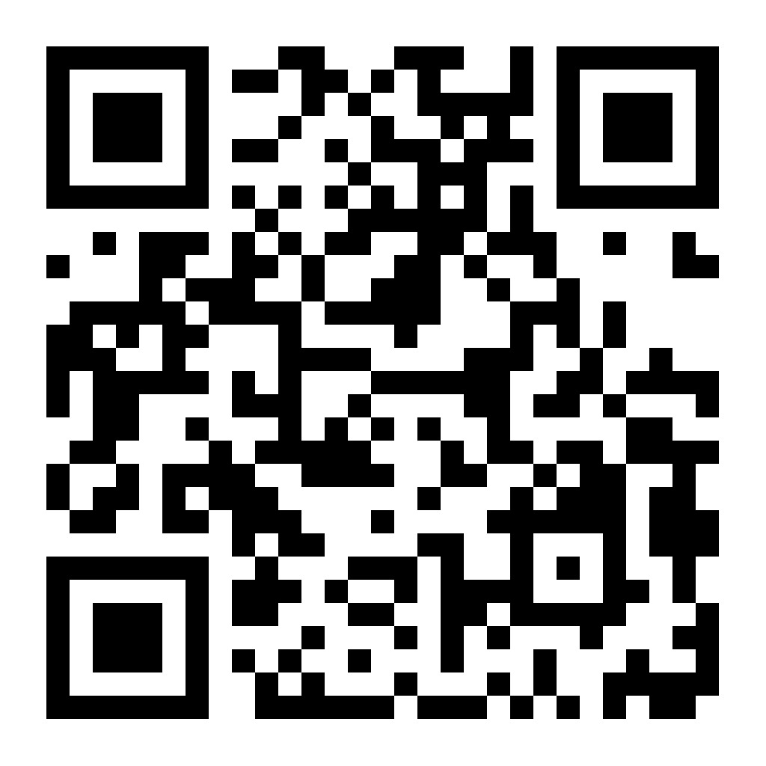
From Asset to Action
Notes:
Leader Guide: Facilitating the “From Asset to Action” Mini-Workshop
Purpose
To guide participants in developing a simple, practical action plan that uses an existing community asset to respond to a local need.
Workshop Flow (25–30 minutes)
1. Setup (2 minutes)
Hand out the Participant Worksheet to each person.
Briefly remind the group of the earlier Community Asset Mapping exercise.
Talking Point:
“Every community has strengths. This activity helps us turn an identified asset into a concrete action we can try within the next 30 days.”
2. Individual Work (10–12 minutes)
Participants work through each section of the worksheet.
Encourage them to: - Choose one specific asset (not the whole wheel) - Be realistic about the next 30 days - Focus on assets they can influence or activate
Facilitator Prompts: - “What’s one asset you feel drawn to explore?”
- “What need in your community keeps coming to mind?”
- “Who already has energy around this idea?”
3. Pair & Share (7–8 minutes)
Participants exchange worksheets with a partner.
Each person should: - Give one affirmation (“This is strong because…”) - Give one improvement suggestion (“This could grow if…”)
Facilitator tip: Keep pairs focused on actionable feedback.
4. Large Group Debrief (5–7 minutes)
Invite a few participants to share their 30-day action steps.
Helpful questions: - “What asset did you choose and why?” - “What’s the first small step you plan to take?” - “Who needs to be involved?”
Capture patterns: common assets, recurring needs, innovative ideas.
Facilitator Tips
Celebrate small steps—“start where you are, use what you have.”
Keep the atmosphere hopeful and creative.
Encourage participants to follow up with each other after the workshop.
Emphasize that ABCD begins with what is strong, not what is wrong.

Slide 10
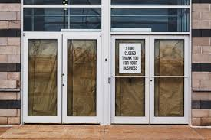
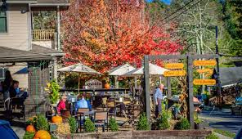

Slide 11
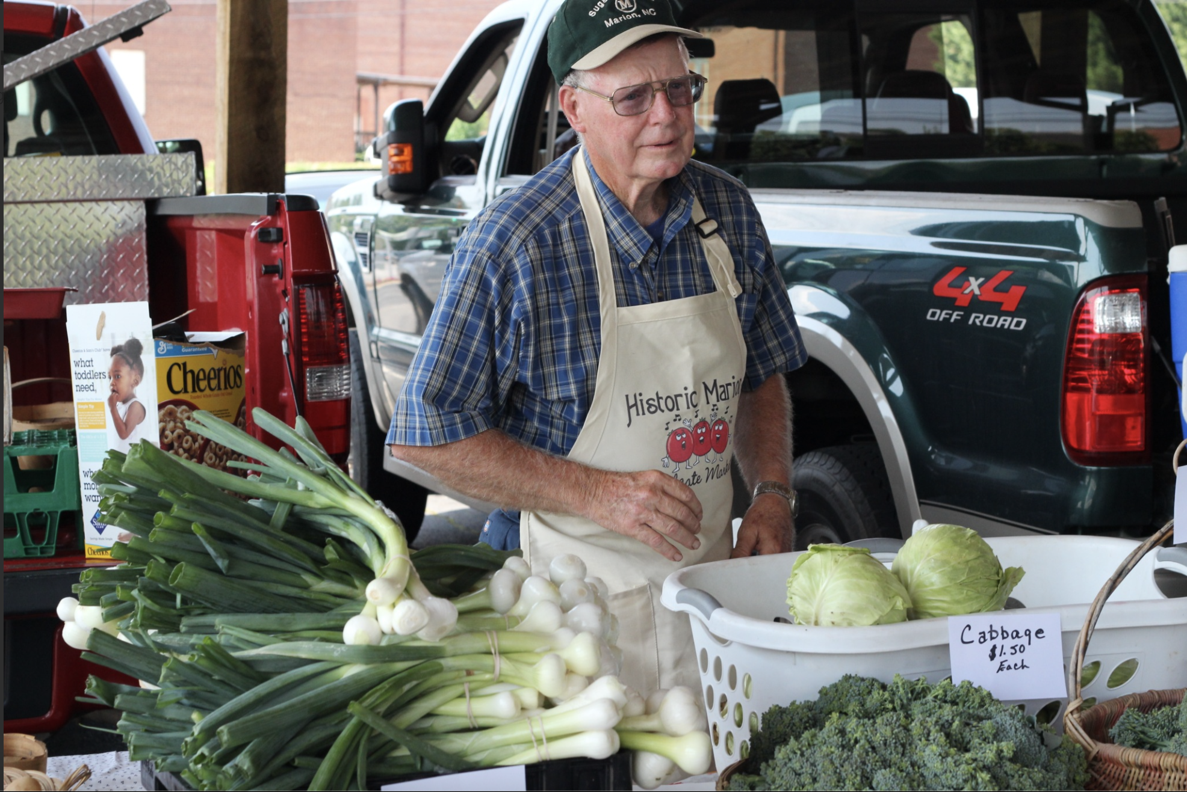
When you look at your community, what do you see first: what’s missing, or what’s possible?

Slide 12
Storytelling...
Guided Discussion Questions:
What did the needs-based approach miss?
What changed when the story shifted to an asset-based view?
How would ABCD shift our organization’s mindset or programs?
What assets in your context are currently overlooked?
Notes:
Story in Notes

Slide 13
Share Out
As groups share, listen for patterns:
What surprised us?
What challenged us?
What possibilities are emerging?

Slide 14
Relationship Building
Empowering community members to utilize and further develop their skills and resources.
How are you encouraging individuals to use their assets to benefit the community?
How are you partnering with churches or other faith communities to use their assets to benefit the community?
Notes:
🤝 2. Relationship Building
Talking Points:
Relationships are the foundation of ABCD. Assets are meaningless if they remain disconnected.
Real change happens at the speed of trust — not at the speed of funding or programming.
This means investing in deep listening, showing up consistently, and being present without an agenda.
Stories, not surveys, are often the most powerful way to uncover gifts and build trust.
Example:
Instead of leading a formal meeting, you sit down over coffee with a neighbor and discover their story — and in doing so, unlock a new direction for your work together.
Engagement Question:
How do you practice listening in your community? Who are you building intentional relationships with?

Slide 15
Collaboration
Where have you seen best practices in building partnerships and networks in your community?
Notes:
🤝🏽 3. Collaboration
Talking Points:
ABCD is inherently collaborative. It’s not about one person or one organization leading everything.
It’s about connecting assets — people, ideas, and institutions — so they can work together toward shared goals.
Collaboration breaks down silos, reduces duplication, and honors the agency of community members.
Importantly, it requires a shift from “doing for” to “doing with.”
Example:
A church, a local school, and neighborhood artists co-create a summer youth arts program — not one entity leading, but each bringing their strengths to the table.
Engagement Question:
What would happen if every organization in your area laid down competition and picked up collaboration? What could you create together?
Closing Connection:
Asset mapping finds the gold,
Relationship building uncovers the story behind it,
And collaboration sets it to work for the good of all.

Slide 16
Focus on the community’s assets instead of solely focusing on the needs
Expand the “US”: Relationships build a community. Intentionally work to build and nourish relationships.
The core of ABCD is community building.

Slide 17
Contact Information
LinkedIn :www.linkedin.com/in/hamidkamara
Email: hkamara@ncruralcenter.org
Phone: 434-250-2357

